Slide 1
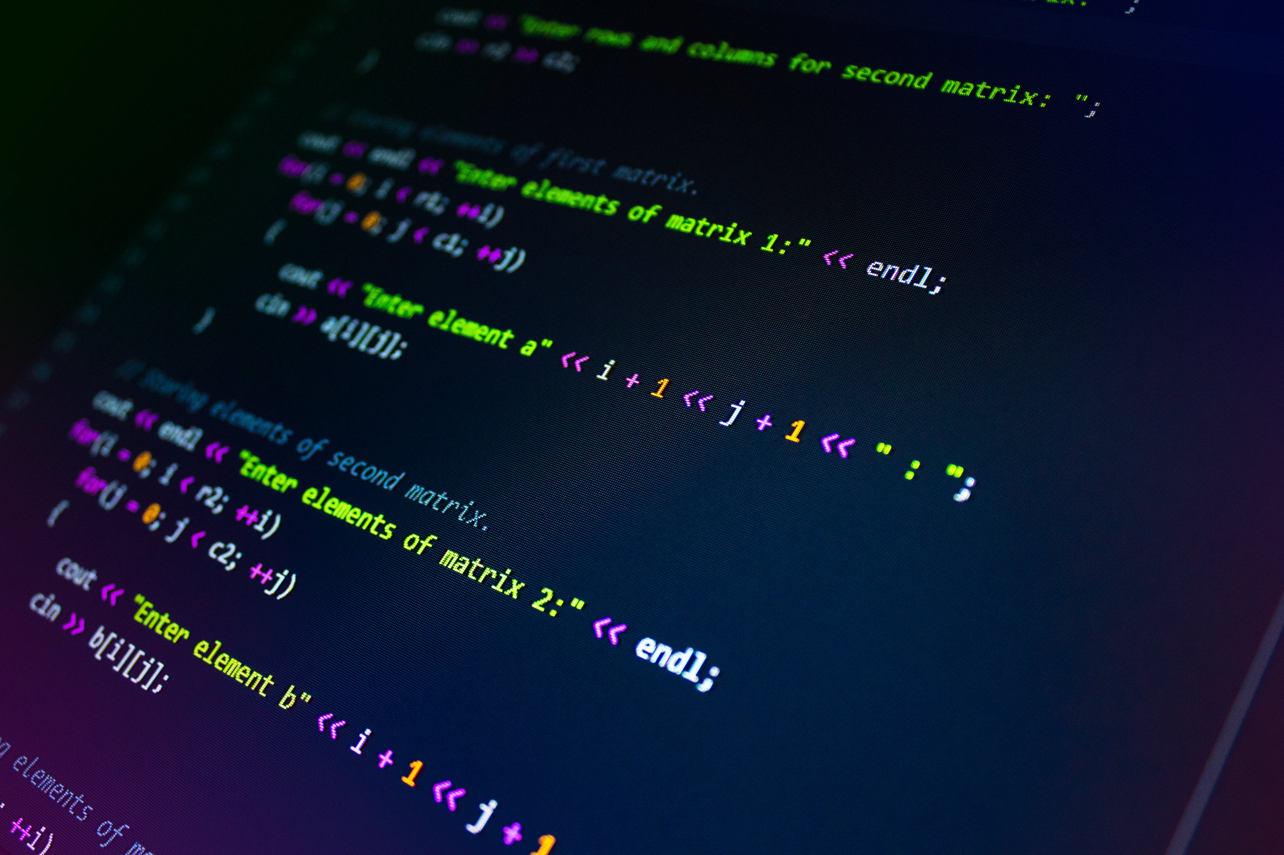

Slide 2


What is the meaning of the name

Slide 3
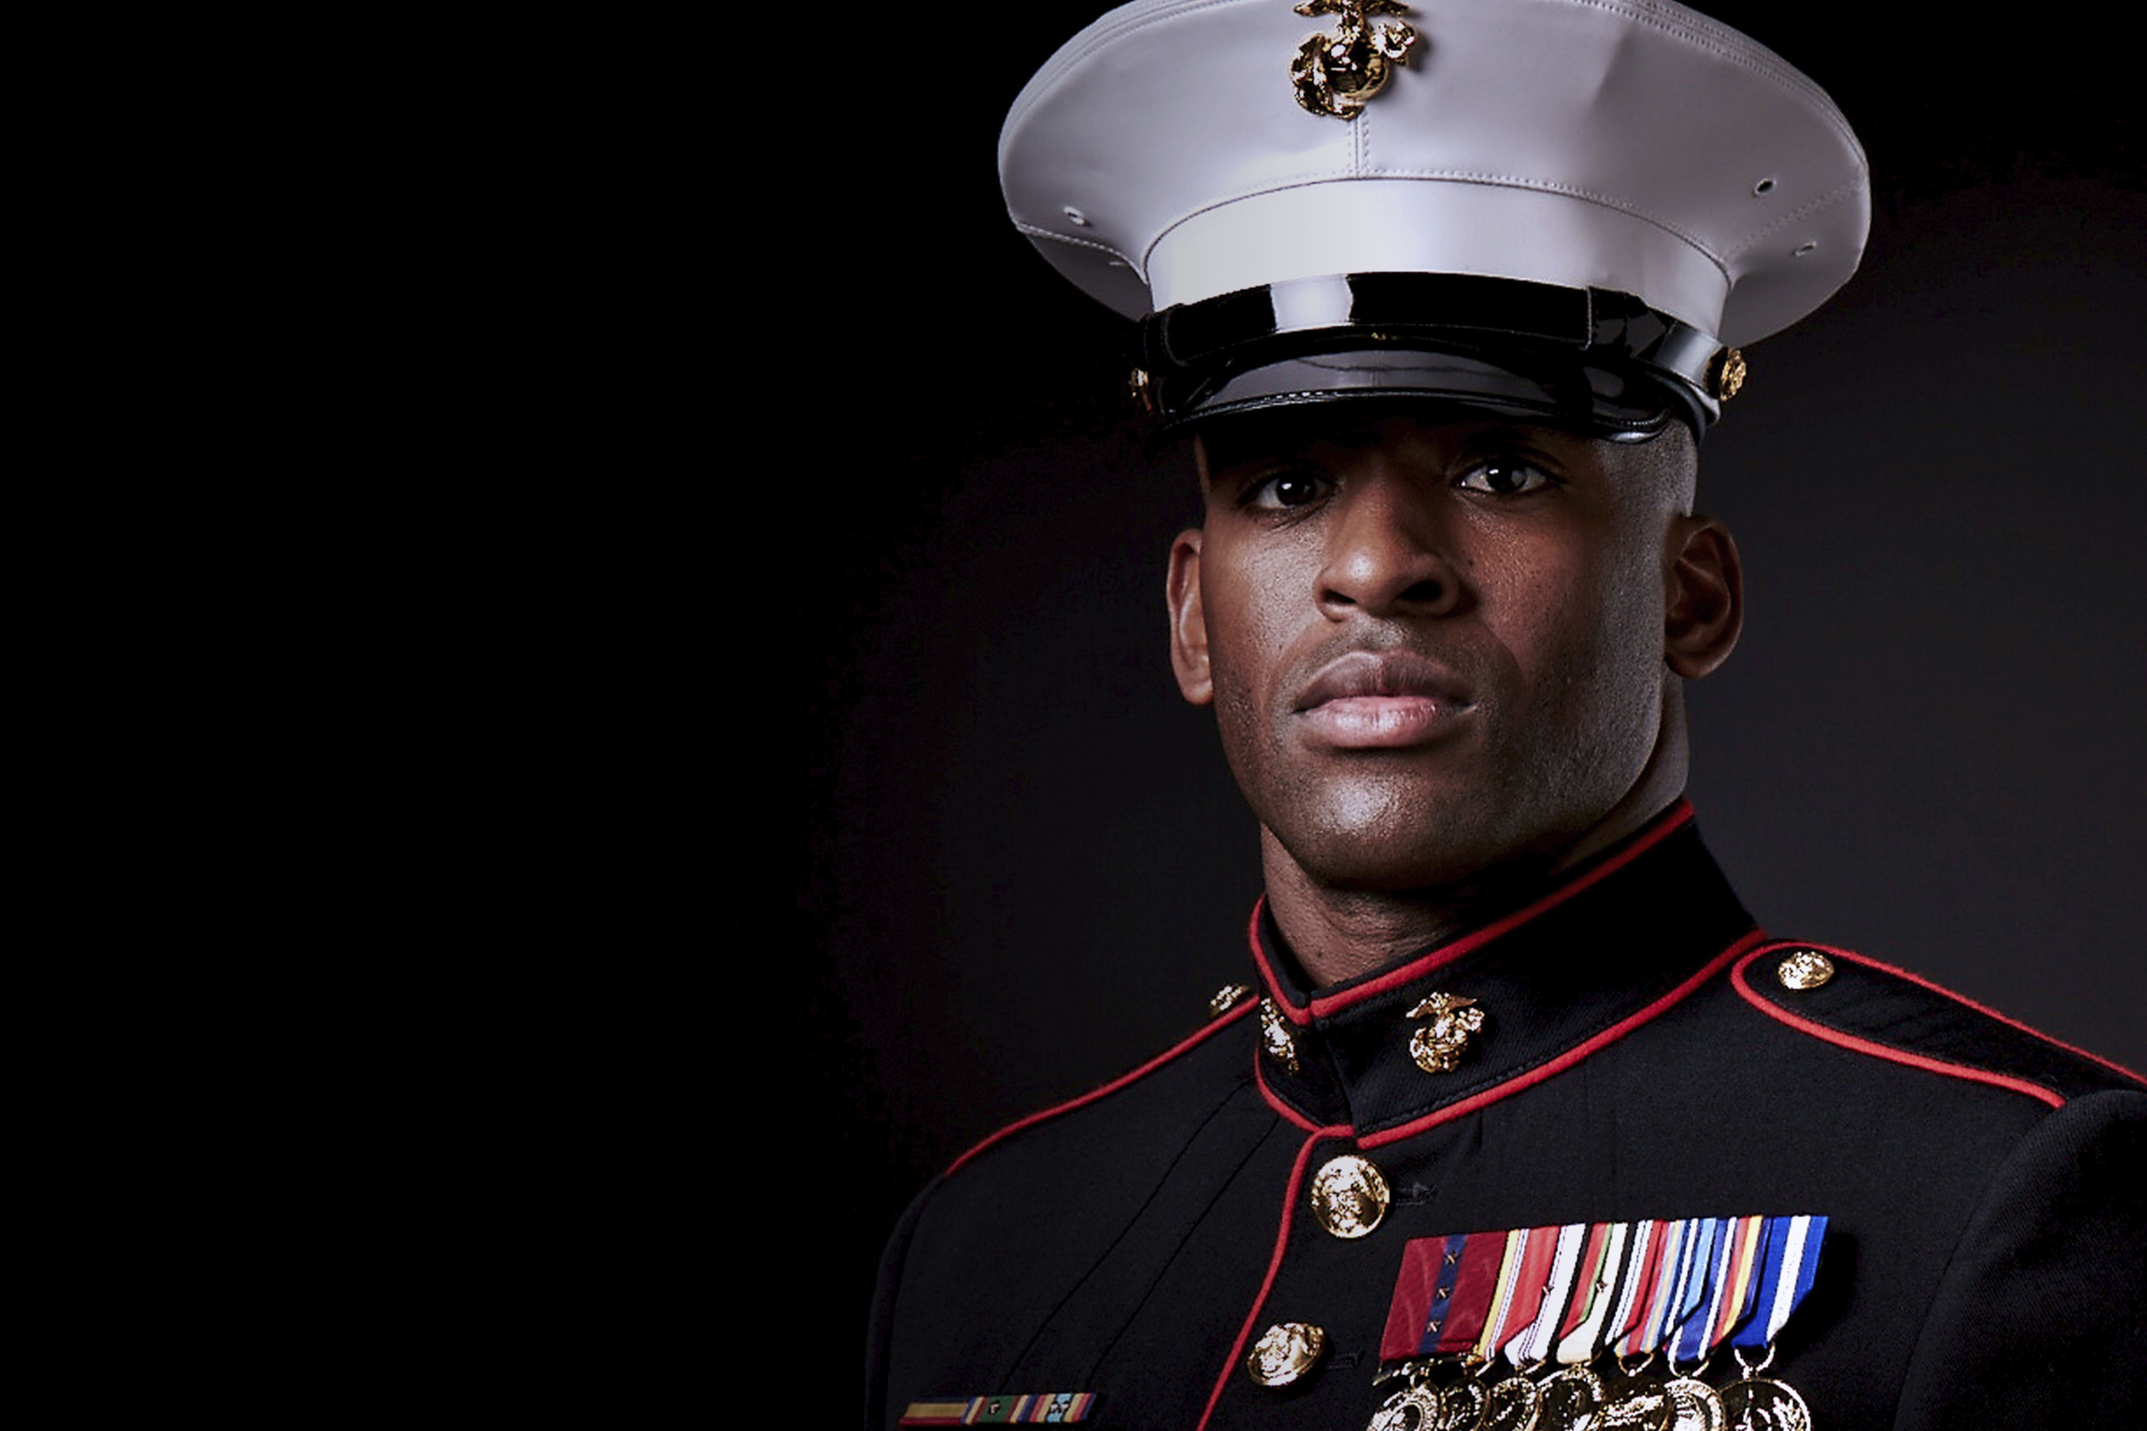

What is the meaning of the name
Army = Power
Sea = Infinite

Slide 4


Implementation
The Solutions
Name
Logo
Visual identity
Problem !
There were many solutions
Difficulty learning programming
But we just want one

Slide 5

SU-Blitz
Programming is EASY

Slide 6
LOGO:
Twisted HTML tags
Slogan:
Programming is easy
Name :
SU - Blitz

Slide 7
LOGO:
Twisted HTML tags
Slogan:
Programming is easy
Name :
SU - Blitz

Slide 8
Users

Slide 9






Our School
Students
Who are already studying Programming
Users
People
Who want to learn Programming

Slide 10
Our School
Students
Who are already studying Programming
People
Who want to learn Programming

Slide 11
Our School
Students
Who are already studying Programming
People
Who want to learn Programming

Slide 12



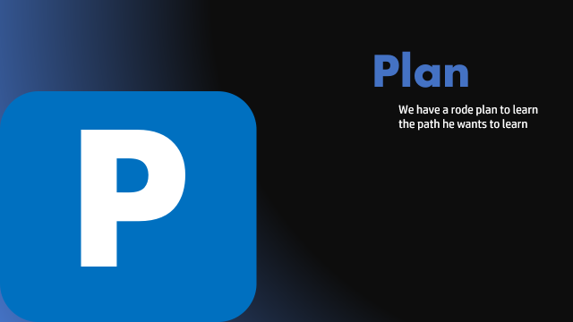

Slide 13
Experience
E
Because we have been through this experience , we know its hardships & obstacles

Slide 14
Plan
P
We have a rode plan to learn the path he wants to learn

Slide 15
C
Comprehensive
Our website contains more than 3 programming languages to put the Person on the right path

Slide 16
S
Ease of use
It is easy for users from 10 years of age to interact with the site

Slide 17

THE
FUTURE ADDITIONS
Translating our website into Arabic to facilitate the learning experience | Focus on adding other Programming languages and organizing them | Make the website viewable on all screens of all sizes | Adding a community section to facilitate interaction between users

Slide 18
TESTING

Slide 19
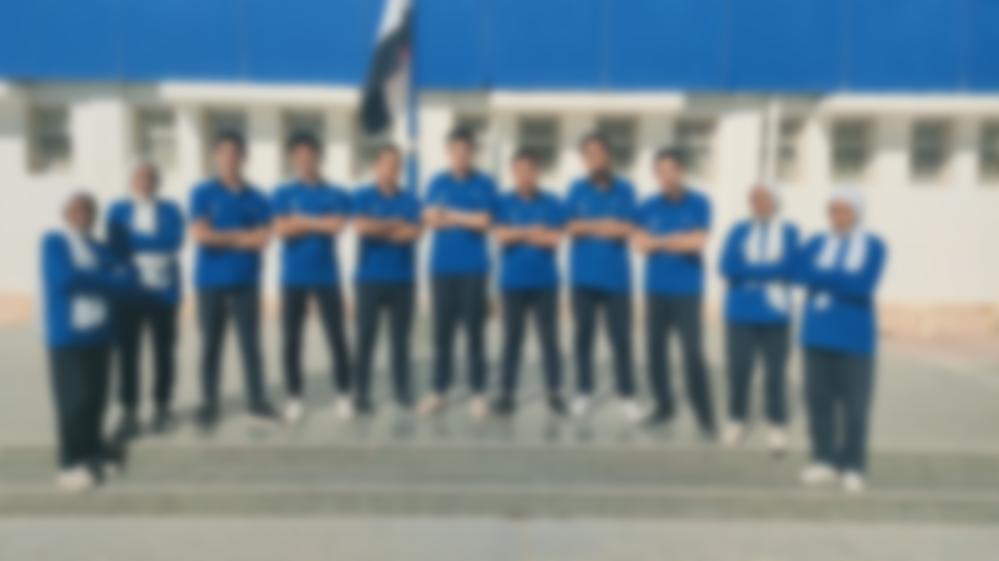
Team Work

Slide 20


